Slide 1
Introduction

Slide 2
Framework
Core
Integration
Logging
Common
Multiplay
Chat
P2P
Stage Navigation
Asset Workflow
Messaging
SFU
Third party
VContainer
UniRx
UniTask
Socket.IO
Unity
Addressable Asset System
Vivox
Netcode for GameObjects
WebRTC

Slide 3
Title screen
Avatar selection screen
Space selection screen
Virtual space
TitleStage
AvatarSelectionStage
SpaceSelectionStage
VirtualStage
Framework
App
App
App
App
CameraControl
CameraControl
CameraControl
CameraControl
Core
InputControl
InputControl
InputControl
InputControl
TitleScreen
NetworkControl
NetworkControl
NetworkControl
Stage
Navigation
PlayerControl
PlayerControl
PlayerControl
AvatarSelectionScreen
LobbyControl
TextChatControl
SpaceSelectionScreen
VoiceChatControl
Stage
ReactionControl
VirtualSpace
Scene

Slide 4
Scene
Third party
VContainer
View
event
Presenter
call
Model
call
event
UniRx

Slide 5
TextChatControl
Framework
Unity
TextChatView
TextChatPresenter
TextChatModel
Integration
<<GameObject>>
TextChatUI
Chat
Vivox

Slide 6
Stage Navigatoin

Slide 7
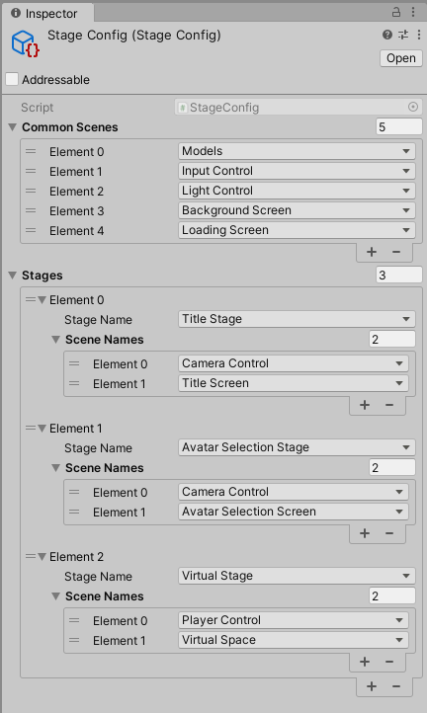

Slide 8
Sample Applicaiton

Slide 9

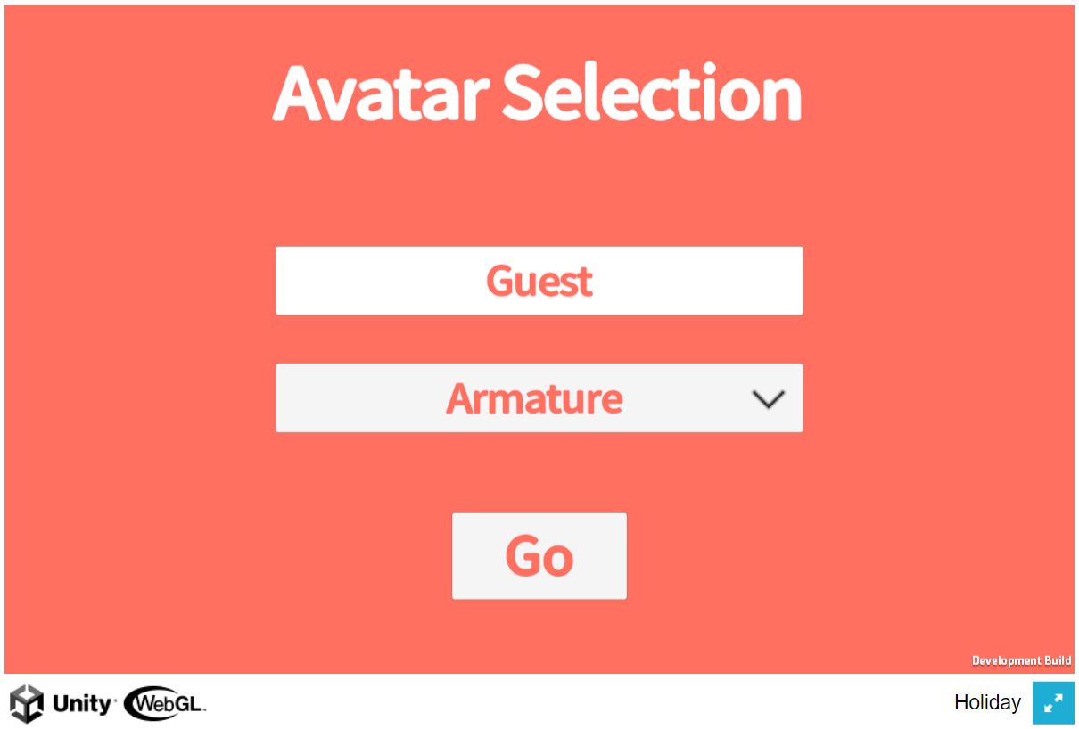
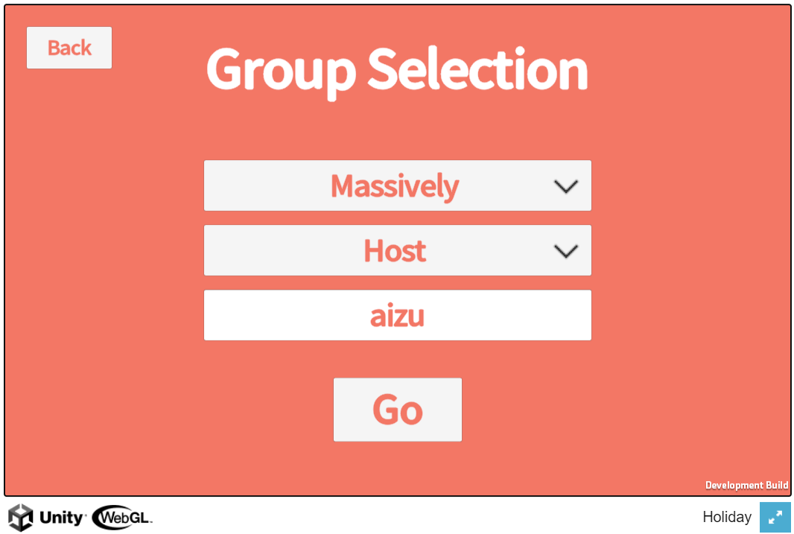
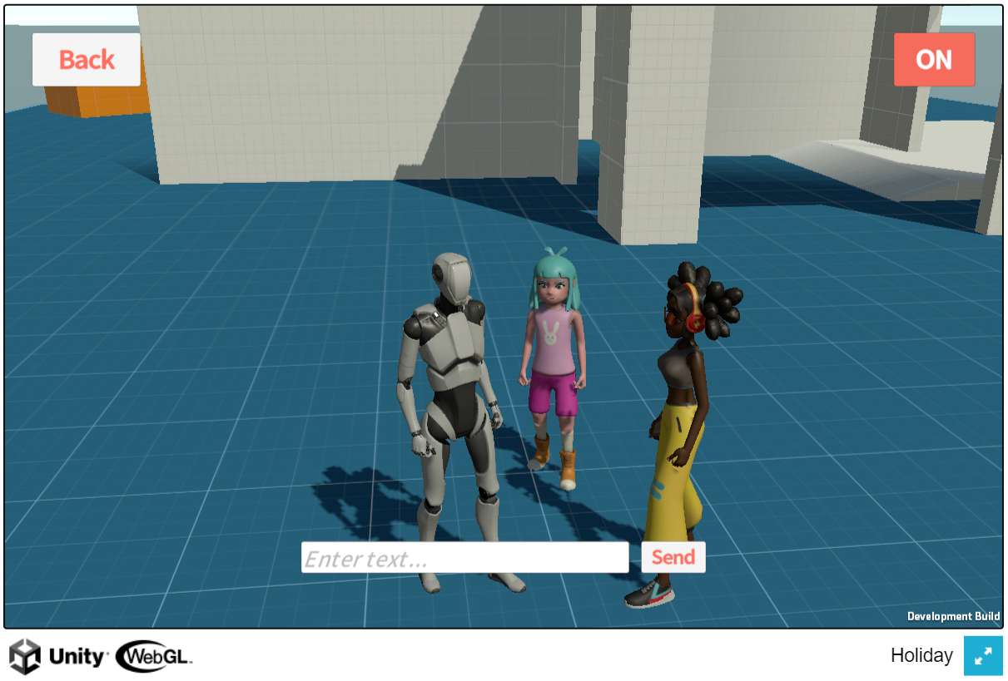
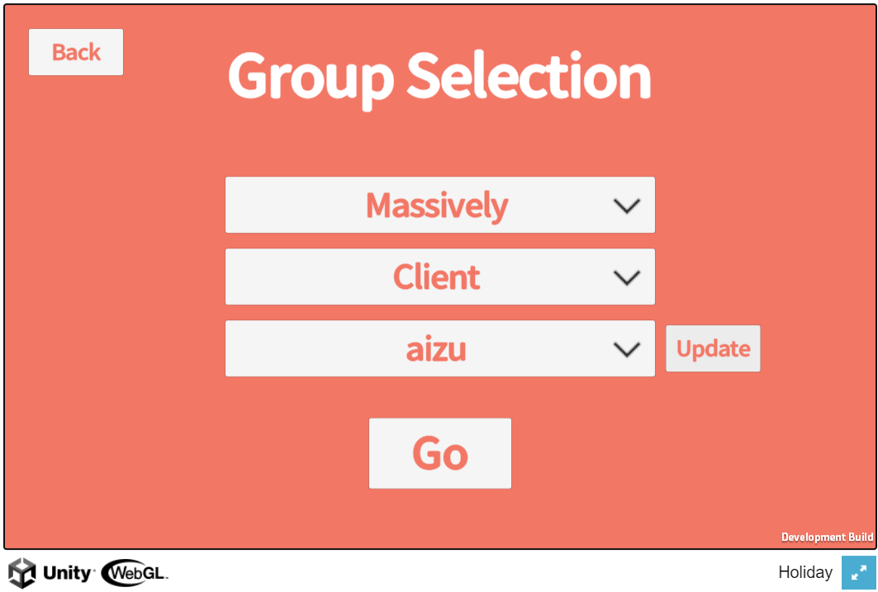

Slide 10
AWS S3
application and assets
download
Messaging (Socket.IO)
(AWS EC2)
upload
User
Multiplay, text chat (Messaging)
setup
use
SFU
SFU
P2P negotiation
Signaling (Socket.IO)
(AWS EC2)
setup
Holiday
(PC Browser)
Developer
Voice chat
(SFU)
P2P negotiation
setup
OME (OvenMediaEngine)
(AWS EC2)
app usage
setup, visualize
AppUsage (Grafana/Loki)
(AWS EC2)

Slide 11
Stage
Scene
Common scenes
TitleStage
AvatarSelectionStage
GroupSelectionStage
VirtualStage
CameraControl
LightControl
App
App
App
App
Entry point
InputControl
BackgroundScreen
LoadingScreen
ConfirmationControl
TitleScreen
ClientControl
ClientControl
ClientControl
NotificationControl
AvatarSelectionScreen
GroupSelectionScreen
SfuControl
RetryStatusControl
MultiplayControl
Scenes by stage
TextChatControl
VoiceChatControl
SpaceControl

Slide 12
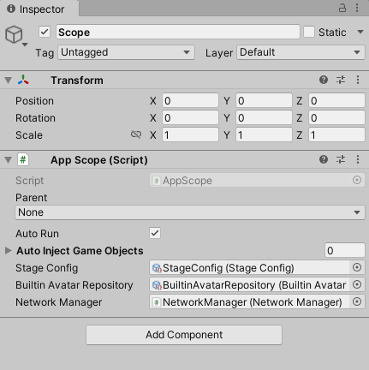
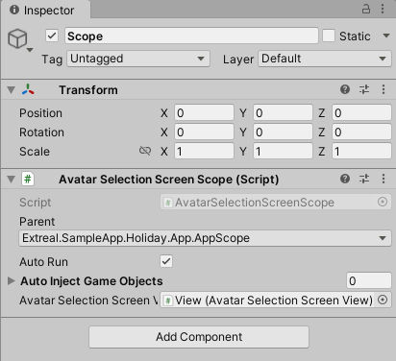
App scene
AvatarSelectionScreen scene

Slide 13
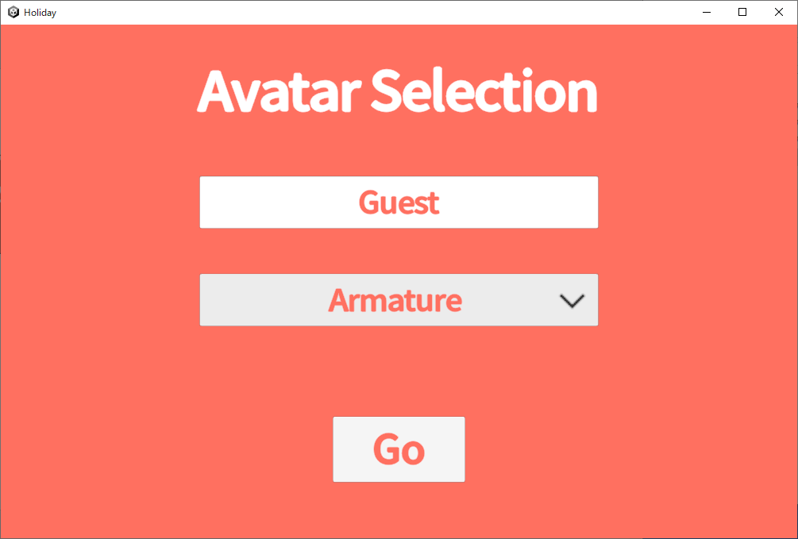
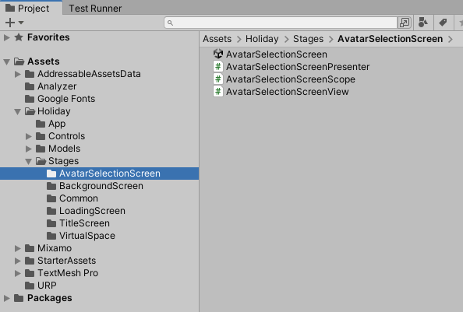
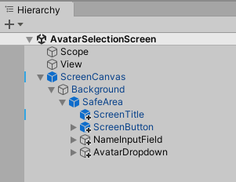
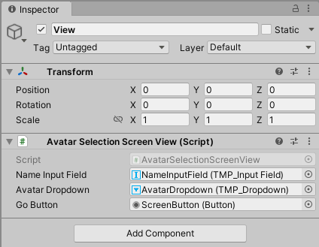

Slide 14
Learning＞Core

Slide 15
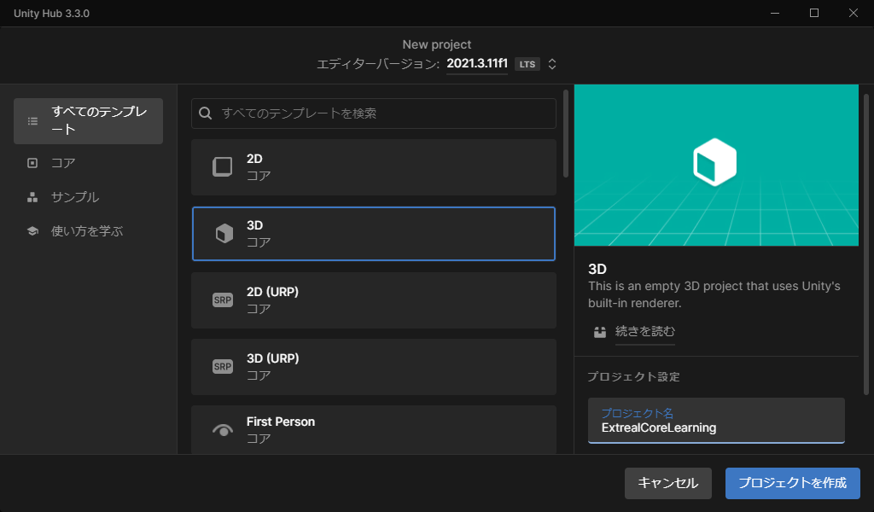

Slide 16
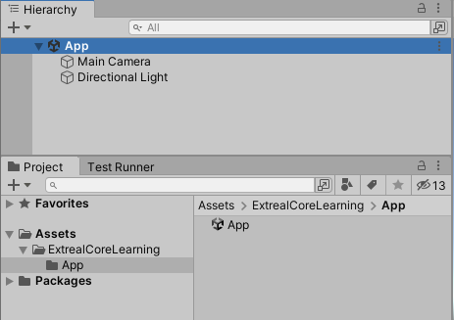

Slide 17
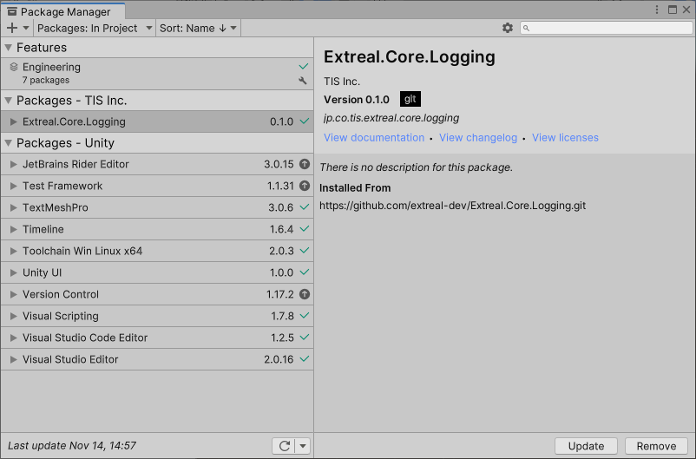

Slide 18
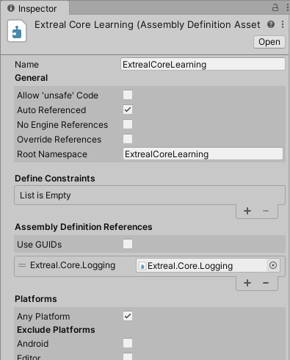
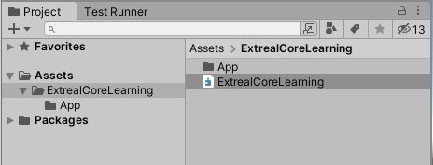

Slide 19
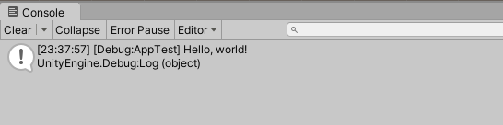

Slide 20
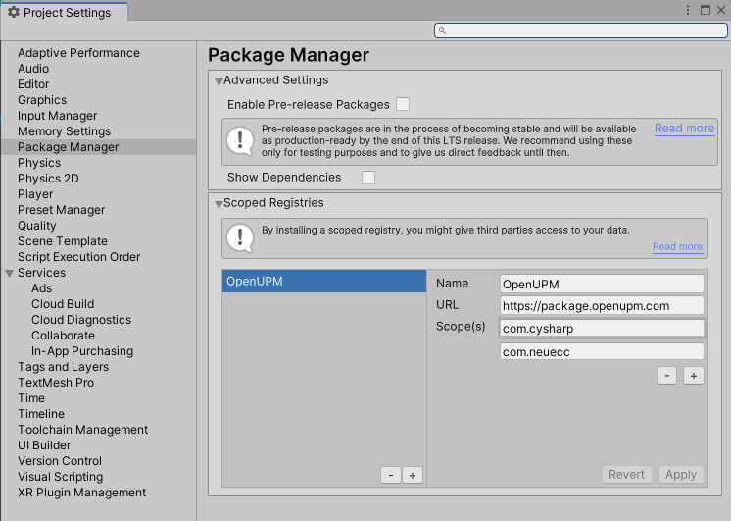

Slide 21
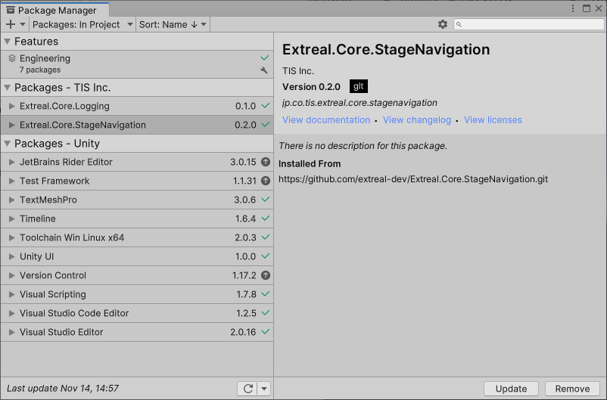
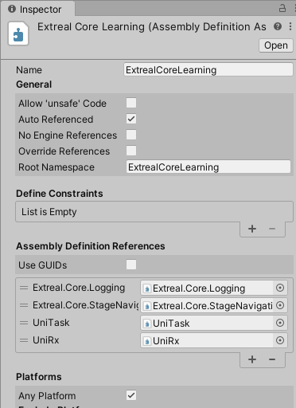

Slide 22
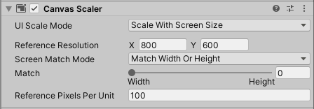

Slide 23
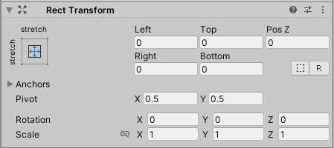
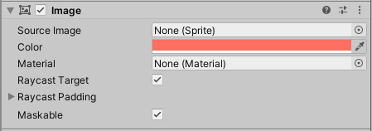

Slide 24
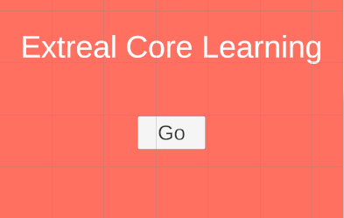

Slide 25
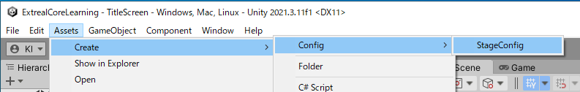
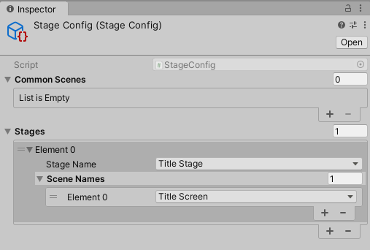
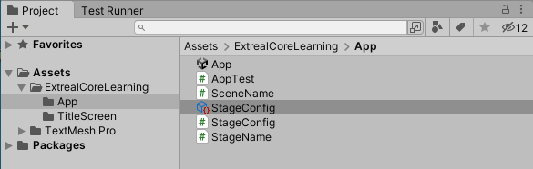

Slide 26
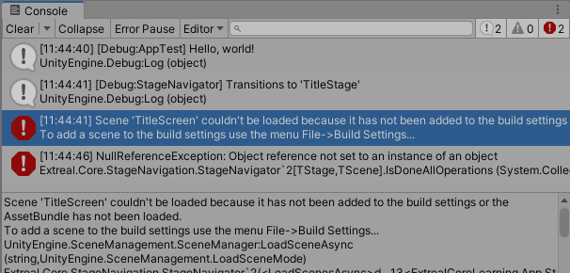

Slide 27
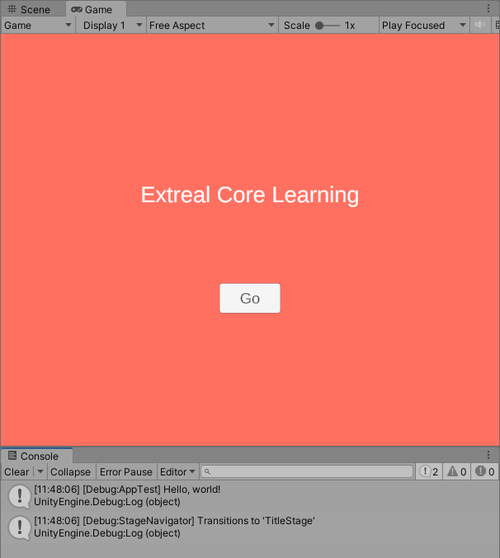

Slide 28
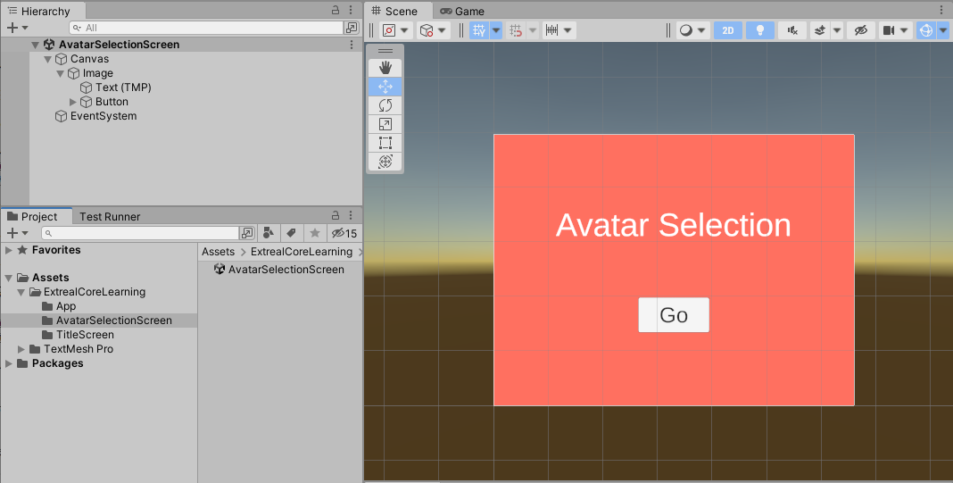

Slide 29
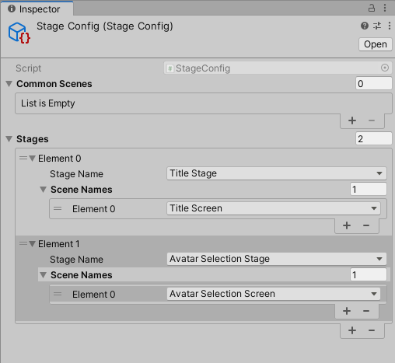

Slide 30


Slide 31
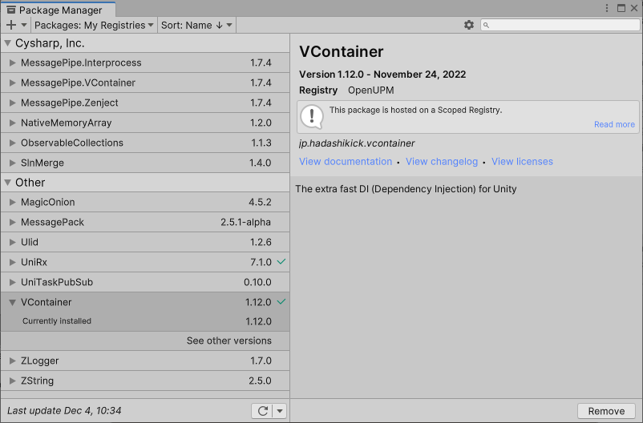
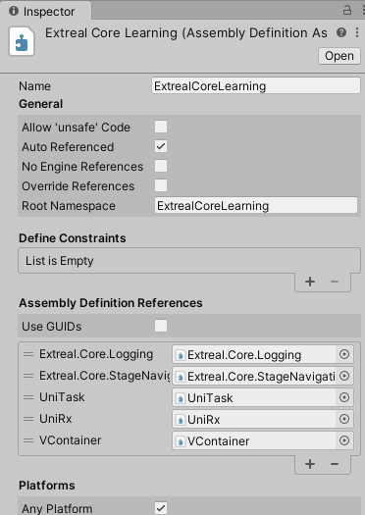

Slide 32
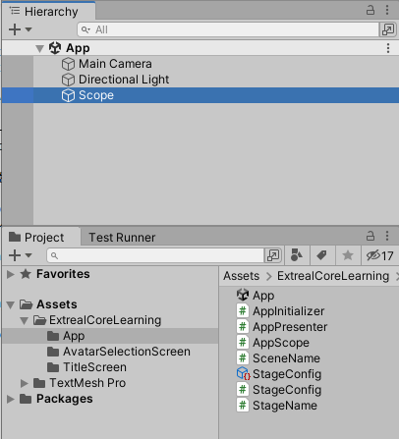
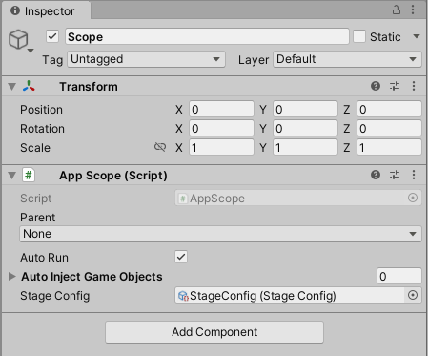

Slide 33
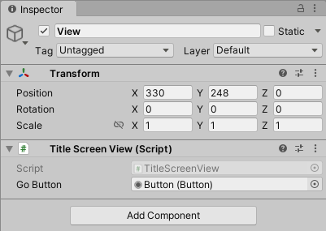
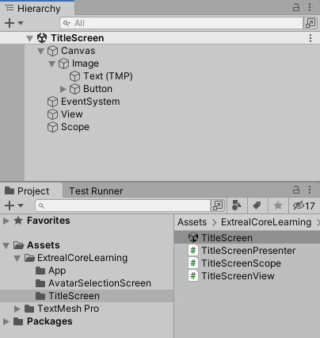
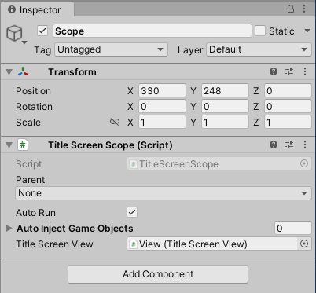

Slide 34
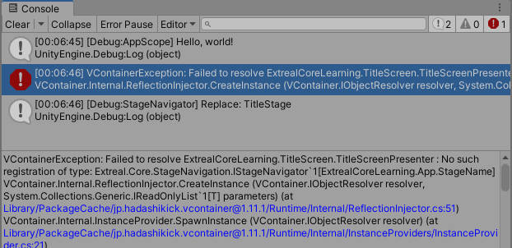

Slide 35
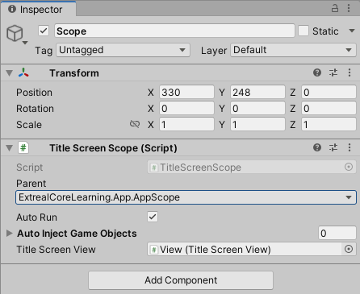

Slide 36
Learning＞Multiplay.NGO

Slide 37
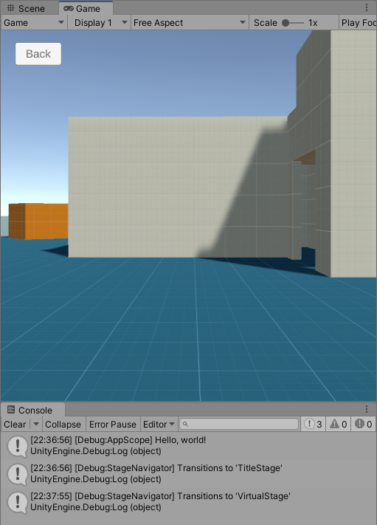
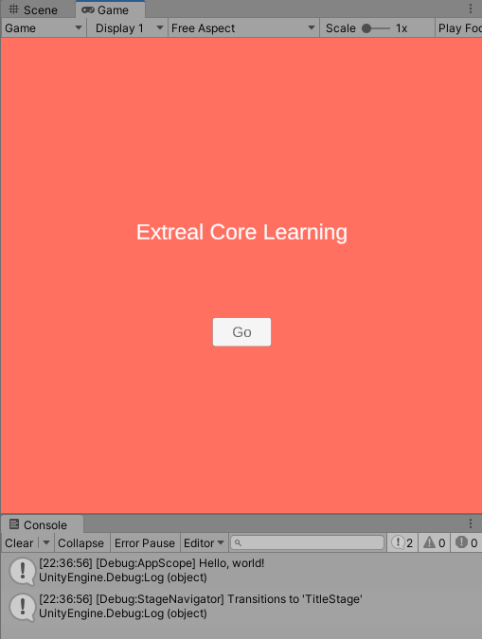

Slide 38
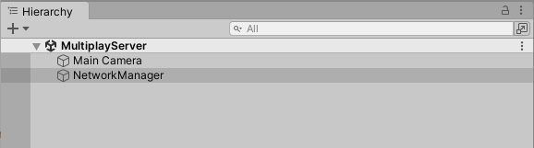
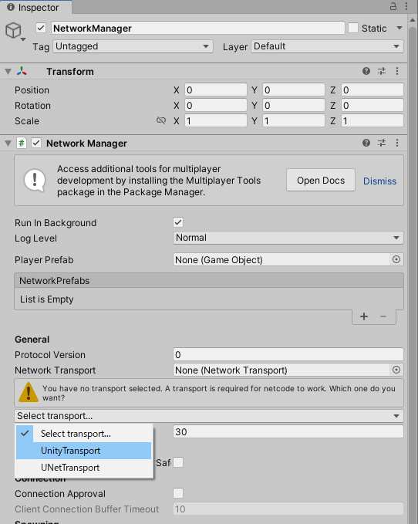
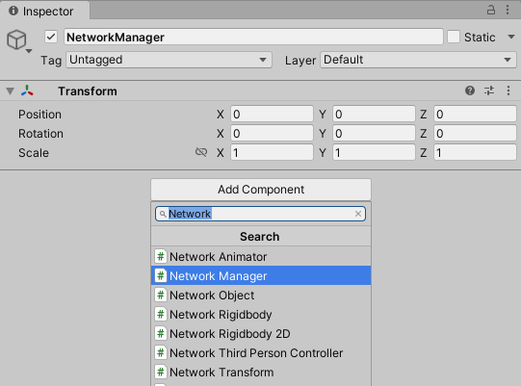

Slide 39
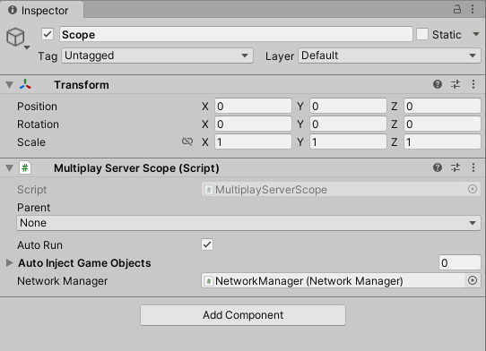
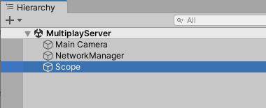

Slide 40
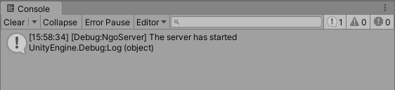

Slide 41
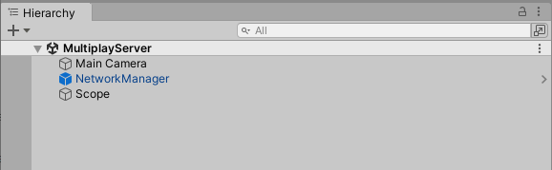
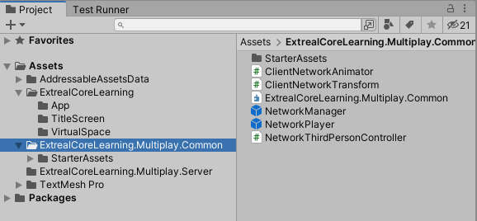

Slide 42




Slide 43



Slide 44



Slide 45






Slide 46


Slide 47
Learning＞Chat.Vivox

Slide 48



Slide 49



Slide 50



Slide 51



Slide 52



